Slide 1

MULTI-THREADED WEBCRAWLER
GROUP NUMBER: 22
GROUP NAME: JICS
GROUP MEMBERS:MALIK SYED,ABDULMUJEEB AHMED, NIKALI WOOD,LEYYENAH SOPHIE
Notes:
Leyyenah:
For our presentation we made a Multi-Threaded Web crawler

Slide 2
MEMBER RESPONSIBILITY
MALIK
MUJEEB
Coding
Powerpoint slides
Coding
Powerpoint slides
NIKA
LEYYENAH
Coding
Powerpoint slides
Coding
Powerpoint slides
Notes:
Leyyenah:
We equally distributed responsibilities between us four and these are each person's roles and what we were tasked with

Slide 3
INTRODUCTION
Objectives:
Functions:
A web crawler is a computer program that's used to search and automatically index website content and other information over the internet. It downloads content from the internet and indexes it. The main purpose is to learn about the different web pages on the internet.
Fetching: Sends requests to download web pages efficiently.
Parsing: Extracts links and content from HTML.
Following: Explores pages by following links.
Indexing: Organizes data for quick retrieval.
Robots.txt: Follows website rules.
Threading: Speeds up crawling by using multiple threads.
Implement a multi-threaded web crawler
Make sure links can be sourced from three different websites
Handle exceptions to ensure it runs efficiently
Notes:
Malik:
A multi-threaded web crawler is like a digital explorer that searches and indexes information across the internet, but in our case we're only scouring through 3 websites.
Our objectives were to successfully implement a multi-threaded web crawler, make sure the links can be sourced from 3 different websites, and to handle exceptions to ensure it runs properly
In order for the web crawler to run it needs to have multiple functions. These are the functions we used.

Slide 4
MOTIVATION
The motivation behind a multi-threaded web crawler is to learn about the different web pages on the internet in a simpler and more efficient manner by simultaneously fetching and processing multiple web pages, which increases the speed of data retrieval and analysis.
The scope of the problem was to gather multiple recipe links.
What is the best way to find valid links?
What is the best way to store the links for easy access?
PROBLEM FORMULATION
Notes:
Malik:
*Read word for word for motivation part*
So for the 3 websites, we decided to go with recipe links.
The two main questions we asked ourselves are...

Slide 5
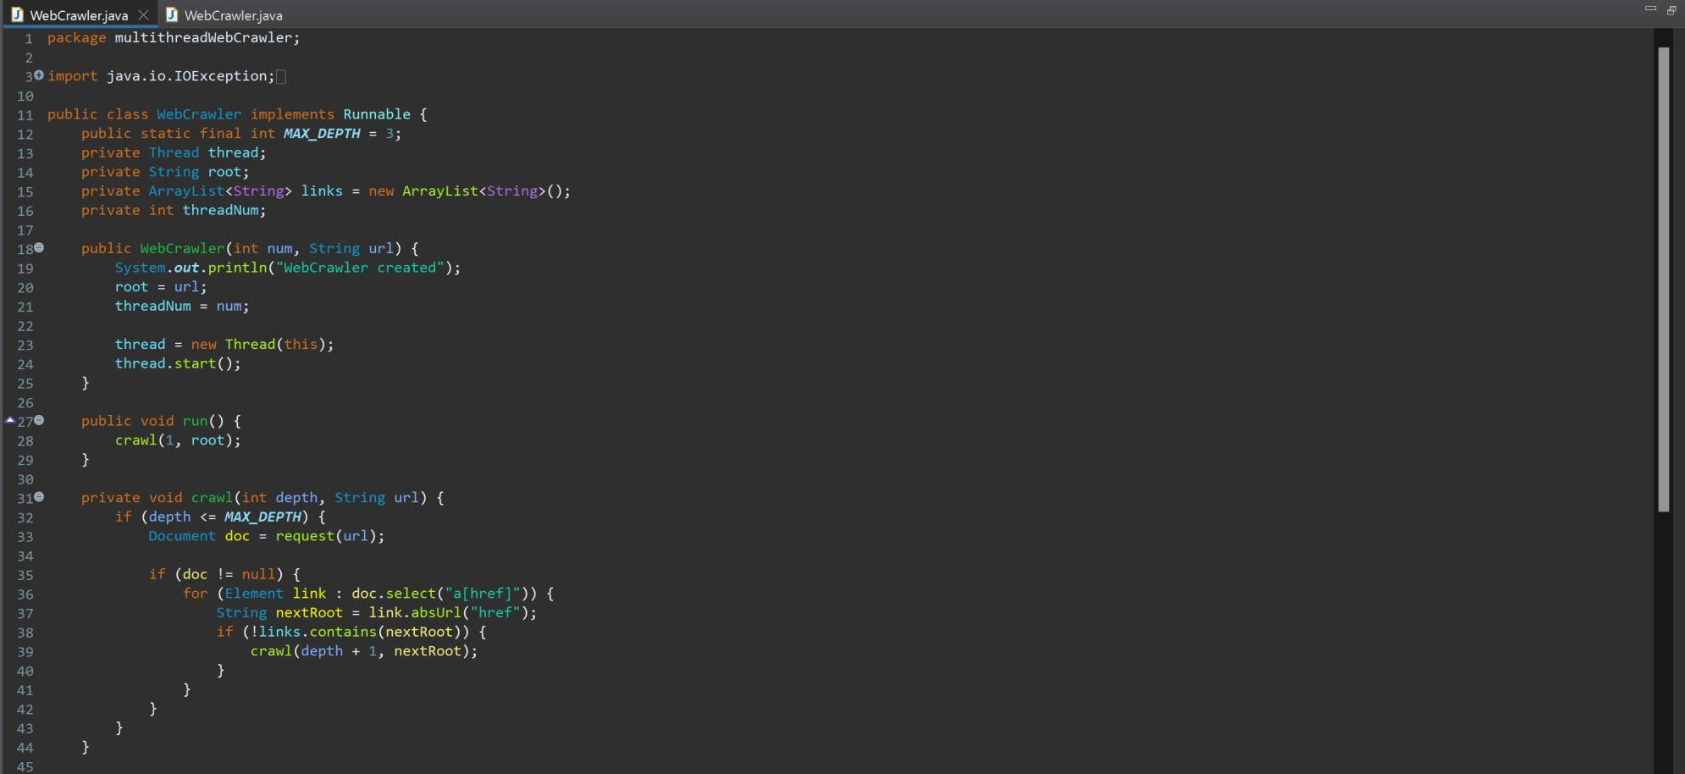
METHOD
This is implementing the runnable interface
The MAX_DEPTH is setting it to 3.
Creates an array to store the links
This is what creates the web crawler instances
This creates a new thread for each instance
This is where the first URL goes and it is
sent into the crawl method
Takes tin the current depth of the crawl and the URL
If the document is not null
It will extract all the links from the specified URL
If the links have not been visited before they are recursively called in crawl & goes to the next level of depth
Notes:
Nika

Slide 6
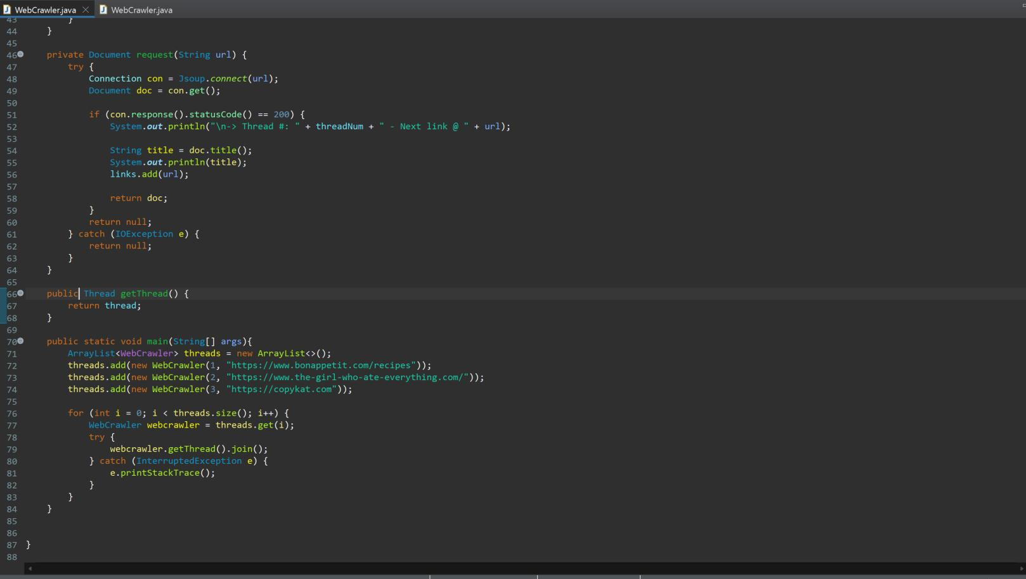
METHOD
Print the title of the document and add the
URL to the visited links array so
it doesn't get visited again
Returns null if it catches an exception
This method returns the thread
object that is associated with the web crawler instance
It creates a new web crawler instance called threads
Iterates over each web crawler instance in the list and uses join to wait for all crawling threads before preceding
Notes:
Nika:

Slide 7
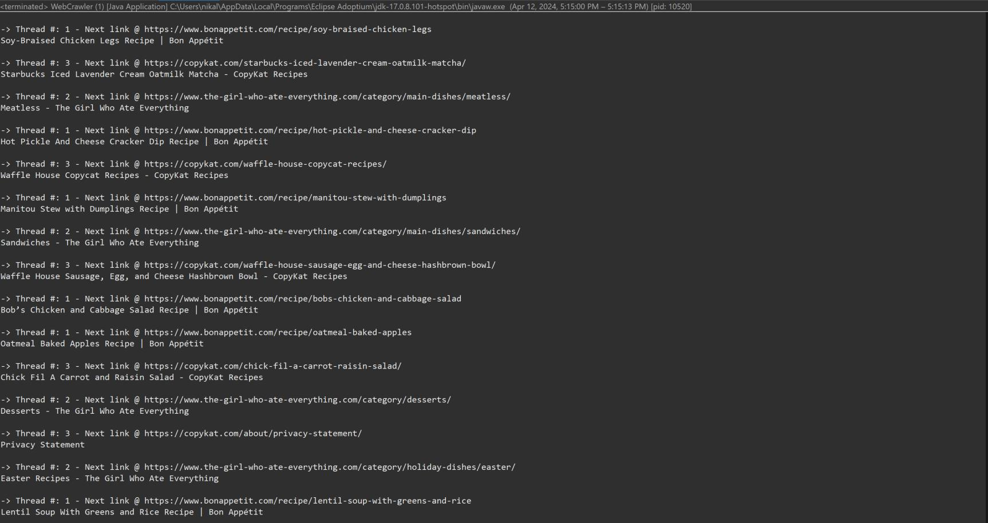
RESULTS
Notes:
Mujeeb

Slide 8
REFERENCES
https://www.cloudflare.com/learning/bots/what-is-a-web-crawler/
https://www.geeksforgeeks.org/what-is-a-webcrawler-and-where-is-it-used/
https://wpdeveloper.com/most-common-web-crawler/
Notes:
Mujeeb:

Slide 9
THANK YOU!

